Slide 1
Bankers' Pay and Social Welfare:
How Bank Profit-seeking and Risk-taking Spillover into the Economy
Robert DeYoung
University of Kansas
Financial Engineering and Banking Society
Nantes, France
June 2015

Slide 2
Do banks generate externalities?
  Negative externality: Systemic Risk
  Normal bank activities (making loans, issuing deposits) require banks to take credit risk and liquidity risk.
  These normal banking risks can cause systemic events and/or expose banks to systemic events.
  Research shows bank CEO pay drives internal risk.
    Chen, Steiner, and Whyte (2006)
    Cheng, Hong and Scheinkman (2010)
    DeYoung, Peng and Yan (2013)
  But no research that bank CEO pay drives external risk.

Slide 3
Do banks generate externalities?
  Positive externality: Liquidity Creation
  Bank lending naturally generates liquidity in the economy (through the loan-money multiplier effect).
  Bank deposits naturally generate liquidity in the economy (by making payments possible).
No research evidence that bank CEO pay influences external liquidity creation.

Slide 4
Do banks generate externalities?
Manager Pay Incentives
Managers make business decisions
Private returns and risk (e.g., to shareholders)
Public returns and risk (externalities)
Problem for estimation: Manager pay packages are endogenous to private returns and risk.
Problem for estimation: In our best measures of systemic risk and liquidity creation, public (external) returns and risk are pooled with private (internal) returns and risk.

Slide 5
DeYoung and Huang
DeYoung, Robert and Minjie Huang. 2015. “The External Effects of Bank Executive Pay: Systemic Risk and Liquidity Creation,” unpublished manuscript.
Work in progress
Will be posted to SSRN in Summer 2015.

Slide 6
DeYoung and Huang
Test whether the externalities generated by large U.S. banking companies (systemic risk, liquidity creation) in 1994-2010 varied with their top executives’ pay incentives.
First stage: Eliminate the pooling problem
Construct a bank-specific measure of systemic risk that is a pure spillover, i.e., it is orthogonal to private risk.
Construct a bank-specific measure of liquidity creation that is a pure spillover, i.e., it is orthogonal to private returns.
Second stage: Test our hypotheses
Regress these pure spillover measures on standard measures of executive pay incentives (delta and vega).
Because externalities do not enter shareholder or manager objective functions, the endogeneity problem disappears.

Slide 7
DeYoung and Huang
We find strong statistical associations between CEO pay incentives and externalities.
  Pay-performance sensitivity (delta)
  reduces the systemic risk externality
  reduces the liquidity creation externality
  Pay-risk sensitivity (vega)
  increases the systemic risk externality
  increases the liquidity creation externality
  Obvious policy tradeoff!
Regulation to limit CEO vega (or encourage CEO delta) will reduce systemic risk, but only at the cost of also reducing liquidity creation.

Slide 8
Three measureable concepts
Executive pay incentives
  Delta and Vega (Core and Guay 2002)
How much liquidity does a bank generate?
  Liquidity generation (Berger and Bouwman 2009)
How systemically important is a bank?
  Systemic Expected Shortfall (Acharya, et al 2010)

Slide 9
1. Executive pay incentives
We use Delta and Vega to measure the performance and risk-taking incentives of the top managers in the bank.

Slide 10
Brief tutorial on Delta and Vega
Delta_{i,t} is the pay-for-performance sensitivity of the CEO.
  Delta = ∂(CEO wealth)/∂(stock price)
  Delta_{i,t} = value of CEO_{i} shares*0.01 + change in value of CEO_{i} options for a 1% change in stock price.
  Theory suggests that high Delta CEOs will be more risk averse.
Vega_{i,t} is the pay-for-risk sensitivity of the CEO.
  Vega = ∂(CEO wealth)/∂(stock price volatility)
  Vega_{i,t} = change in value of CEO_{i} options for 0.01 change in stock return volatility from standard option pricing model.
  Theory suggests that high Vega CEOs will be less risk averse.

Slide 11
Source: DeYoung, Peng and Yan (2013)

Slide 12
A 1% increase in stock price ➔ $800,000 increase in CEO wealth
Source: DeYoung, Peng and Yan (2013)

Slide 13
$ thousands
A 0.01 increase in stock return variation ➔ $300,000 increase in CEO wealth
Gramm-Leach-Bliley
Source: DeYoung, Peng and Yan (2013)

Slide 14
2. Bank liquidity creation
We use Berger and Bouwman’s (2009) preferred measure of bank liquidity creation in our main tests.

Slide 15
Brief liquidity creation tutorial
Step 1: Classify liquid and illiquid activities
ASSETS
LIABILITIES + EQUITY
Liquid Assets
e.g., securities
Liquid Liabilities
e.g., transactions deposits
Semi-liquid Assets
e.g., home mortgages
Semi-liquid Liabilities
e.g., time deposits
Illiquid Assets
e.g., business loans
Illiquid Liabilities + Equity
OFF-BALANCE SHEET
Illiquid Guarantees, e.g., loan commitments
Liquid Derivatives (gross fair values)

Slide 16
Brief liquidity creation tutorial
Step 2: Assign weights
Weight
ASSETS
LIABILITIES + EQUITY
Weight
- 0.5
Liquid Assets
e.g., securities
Liquid Liabilities
e.g., transactions deposits
+ 0.5
Semi-liquid Assets
e.g., home mortgages
0
Semi-liquid Liabilities
e.g., time deposits
0
Illiquid Assets
e.g., business loans
+ 0.5
Illiquid Liabilities + Equity
- 0.5
OFF-BALANCE SHEET
+ 0.5
Illiquid Guarantees, e.g., loan commitments
- 0.5
Liquid Derivatives (gross fair values)

Slide 17
Brief liquidity creation tutorial
Step 3: liquidity creation = Σ (weight * $activity)/assets
Weight
ASSETS
LIABILITIES + EQUITY
Weight
- 0.5
Liquid Assets
e.g., securities
Liquid Liabilities
e.g., transactions deposits
+ 0.5
Semi-liquid Assets
e.g., home mortgages
0
Semi-liquid Liabilities
e.g., time deposits
0
Illiquid Assets
e.g., business loans
+ 0.5
Illiquid Liabilities + Equity
- 0.5
OFF-BALANCE SHEET
+ 0.5
Illiquid Guarantees, e.g., loan commitments
- 0.5
Liquid Derivatives (gross fair values)

Slide 18
3. Systemic risk
Which one should we use?
CoVaR (Adrian and Brunnermeier, 2011)
Systemic Expected Shortfall (Acharya, et al., 2010)
Pooling problem: Systematic risk is embedded in both CoVar and SES (Guntay and Kupiec 2014, Loffler and Raupach 2014).
CoVar is a contribution measure.
But SES has better properties for panel estimation. Unlike CoVaR, it can be calculated for each bank i in each year t.
We use SES in our main tests.
SES_{it} = the loss of equity value for banking company i during year t, scaled by year-end bank equity value.

Slide 19
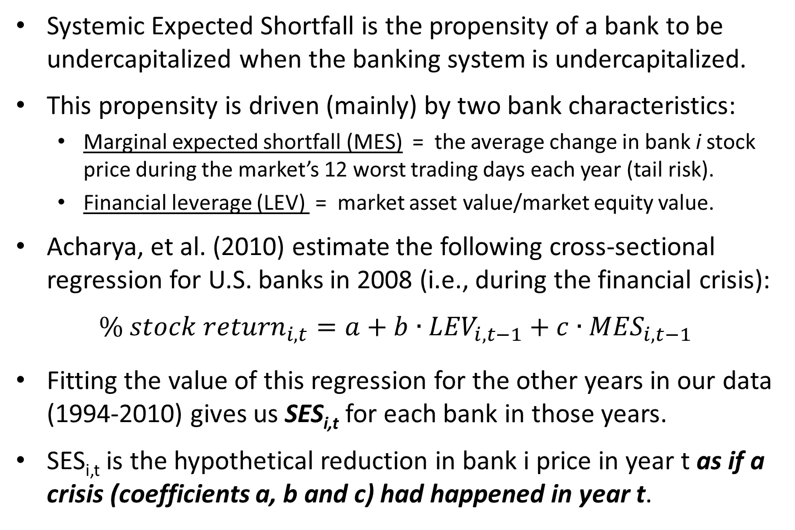
Brief SES tutorial
Systemic Expected Shortfall is the propensity of a bank to be undercapitalized when the banking system is undercapitalized.
This propensity is driven (mainly) by two bank characteristics:
  Marginal expected shortfall (MES) = the average change in bank i stock price during the market’s 12 worst trading days each year (tail risk).
  Financial leverage (LEV) = market asset value/market equity value.
Acharya, et al. (2010) estimate the following cross-sectional regression for U.S. banks in 2008 (i.e., during the financial crisis):
$${\% stock return}_{i,t}=a+b∙{LEV}_{i,t−1}+c∙{MES}_{i,t−1}$$
Fitting the value of this regression for the other years in our data (1994-2010) gives us SES_{i,t} for each bank in those years.
SES_{i,t} is the hypothetical reduction in bank i price in year t as if a crisis (coefficients a, b and c) had happened in year t.

Slide 20
First stage: Capturing external liquidity creation
TLCA_{i,t} = dollars of liquidity created per dollar of assets at banking company i during year t.
  TLCA pools liquidity created in pursuit of private returns with liquidity that spills over (the externality).
We use pooled OLS estimation to separate public returns (the externality) from private returns:
TLCA_{it} = a + b∙ROA_{it} + c∙Δmkt value/assets_{it} + ε^{TLCA}_{it}
By OLS, the residual ε^{TLCA}_{it} is orthogonal to private returns (ROA_{it} and Δmkt value/assets_{it}).

Slide 21
First stage: Capturing external systemic risk
SES_{it} = the percentage loss of banking company i’s equity value during year t.
  SES pools systematic risk and other private risk with systemic risk that spills over (the externality).
We use pooled OLS estimation to separate public risk (the externality) from private risks:
SES_{it} = a + b∙Beta_{it} + c∙Z-score_{it} + ε^{SES}_{it}
By OLS, the residual ε^{SES}_{it} is orthogonal to private risk (Beta_{it} and Z-score_{it}).

Slide 22
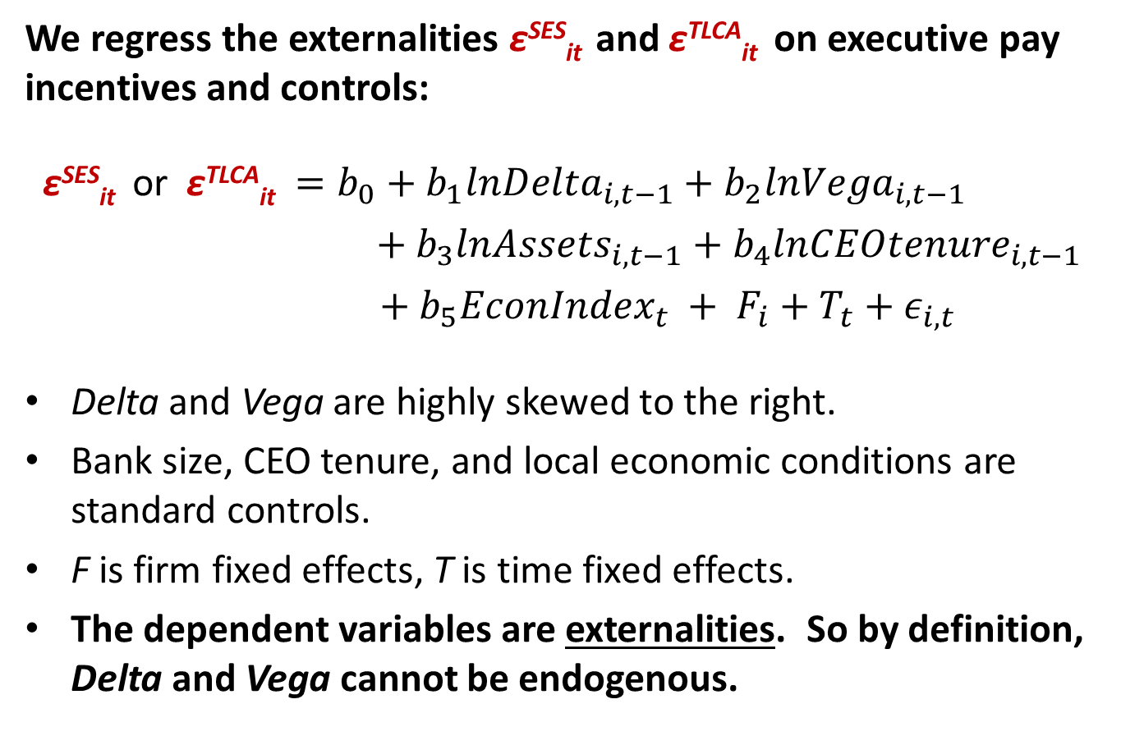
Second stage: The main tests
We regress the externalities ε^{SES}_{it} and ε^{TLCA}_{it} on executive pay incentives and controls:
ε^{SES}_{it} or ε^{TLCA}_{it} $=b_{0}+b_{1}{lnDelta}_{i,t−1}+b_{2}{lnVega}_{i,t−1}$
$$+ b_{3}{lnAssets}_{i,t−1}+b_{4}{lnCEOtenure}_{i,t−1}$$
$${+ b}_{5}{EconIndex}_{t} + F_{i}+T_{t}+ε_{i,t}$$
Delta and Vega are highly skewed to the right.
Bank size, CEO tenure, and local economic conditions are standard controls.
F is firm fixed effects, T is time fixed effects.
The dependent variables are externalities. So by definition, Delta and Vega cannot be endogenous.

Slide 23
Data and key variables
Data includes 945 bank-year observations (147 different banks) from 1994-2010.
Observe 46 to 74 banks in any given year.
Key variables:
  The variables that limit the size of our sample are Delta and Vega (calculated from Execucomp and CRSP data)
  Measured liquidity creation (from Bouwman website)
  Measured systemic risk, SES (calculated from CRSP data; based on Acharya, et al. 2010)
  Private returns: ROA and Δmarket cap/assets (Federal Reserve, CRSP)
  Private risk: Beta and Z-score (estimated from CRSP and Federal Reserve data)

Slide 24
Table 2: Summary statistics
945 bank-year observations, 1994-2010, winsorized at 1% and 99%
 | Mean | Std Dev
Assets ($1,000,000s) | 71,849 | 188,233
TLC ($1,000,000s) | 38,707 | 95,834
TLCA | 0.423 | 0.174
ε_{TLCA} | -0.019 | 0.185
ΔMktCap/Assets (%) | 1.73 | 5.51
ROA (%) | 1.07 | 0.7
SES | 0.095 | 0.048
ε_{SES} | 0 | 0.043
Beta | 1.06 | 0.47
Z Score | 26.02 | 8.27
Delta ($) (CEO) | 525,482 | 752,954
Vega ($) (CEO) | 95,058 | 185,232
CEO tenure | 7.46 | 5.7
Economic Index | 135.69 | 16.62

Slide 25
Table 3: Liquidity creation externality
 | First stage
 | [5]
Dependent var: | TLCA _{t}
lnDelta _{t-1}
lnVega _{t-1}
lnAssets _{t-1}
lnCEOtenure _{t-1}
Econ Index _{t}
ROA _{t} | 4.688***
ΔMktCap/Assets _{t} | 0.718*
Constant | 0.385***
Fixed effects | None
Adjusted R² | 0.032
Within R²

Slide 26
Table 3: Liquidity creation externality
 | First stage | Second Stage
 | [5] | [6] | [7] | [8] | [9]
Dependent var: | TLCA _{t} | ε_{TLCA t} | ε_{TLCA t} | ε_{TLCA t} | ε_{TLCA t}
lnDelta _{t-1} |  | -0.0465*** | -0.0574*** | -0.0418*** | -0.0393***
lnVega _{t-1} |  | 0.00458** | 0.00610** | 0.00599*** | 0.00599***
lnAssets _{t-1} |  | 0.0658** | 0.0680** | 0.00719 | 0.0109
lnCEOtenure _{t-1} |  | 0.0218** | 0.0163* | -0.015 | -0.0215
Econ Index _{t} |  | -0.00219 | -0.00209 | -0.000664 | -0.000946
ROA _{t} | 4.688***
ΔMktCap/Assets _{t} | 0.718*
Constant | 0.385*** | -0.267 | -0.204 | 0.0694 | 0.0872
Fixed effects | None | Firm and Year | Firm and Year | Firm-CEO and Year | Firm-CEO and Year
Managers |  | CEO | Top 5 | CEO | Top 5
Adjusted R² | 0.032
Within R² |  | 0.273 | 0.278 | 0.286 | 0.279

Slide 27
Table 4: Systemic risk externality
 | First stage
 | [5]
Dependent var: | SES _{t}
lnDelta _{t-1}
lnVega _{t-1}
lnAssets _{t-1}
lnCEOtenure _{t-1}
Econ Index _{t}
beta _{t} | 0.0342***
Z Score _{t} | -0.0011***
Constant | 0.0868***
Fixed effects | None
Adjusted R² | 0.159
Within R²

Slide 28
Table 4: Systemic risk externality
 | First stage | Second Stage
 | [5] | [6] | [7] | [8] | [9]
Dependent var: | SES _{t} | ε_{SES t} | ε_{SES t} | ε_{SES t} | ε_{SES t}
lnDelta _{t-1} |  | -0.0133*** | -0.0223*** | -0.0173*** | -0.0245***
lnVega _{t-1} |  | 0.000488** | 0.00063*** | 0.00053*** | 0.00056***
lnAssets _{t-1} |  | 0.0265*** | 0.0301*** | 0.0120** | 0.0171***
lnCEOtenure _{t-1} |  | 0.00384** | 0.00350* | 0.00946* | 0.00798*
Econ Index _{t} |  | -0.000376 | -0.000345 | -0.00098** | -0.00114**
beta _{t} | 0.0342***
Z Score _{t} | -0.0011***
Constant | 0.0868*** | -0.147 | -0.13 | 0.0663 | 0.0871
Fixed effects | None | Firm and Year | Firm and Year | Firm-CEO and Year | Firm-CEO and Year
Managers |  | CEO | Top 5 | CEO | Top 5
Adjusted R² | 0.159
Within R² |  | 0.314 | 0.365 | 0.346 | 0.386

Slide 29
Policy Implications
  Regulators have started to restrict bank executive pay.
  In Europe:
    Bonuses capped at 100% of fixed pay.
    40% to 60% of variable pay must be deferred by 3 to 5 years.
  In US:
    Bonuses prohibited if retained earnings are negative and capital conservation buffer is less than 2.5%.
    Three general “principles” for executive pay:
    Should prudently balance risk and financial results.
    Risk-management processes designed to support this.
    Active board oversight of executive pay practices.

Slide 30
Policy Implications
  Our estimations indicate that pay regulations aimed at reducing bank risk-taking will result in a tradeoff:
  Risk spillovers will decline.
  Liquidity spillovers will also decline.
  Our estimates suggest economically meaningful impacts:
 | estimated %Δ in aggregate liquidity spillover | estimated %Δ in aggregate risk spillover
+1 std. dev. in lnDelta | -4.22% | -8.23%
+1 std. dev. in lnVega | 2.28% | 0.97%

Slide 31
Robustness Tests
Results robust to:
  Additional private risk and return variables in first stage
  Removing SIFI banks from data
  Using time fixed effects in first stage
  Using GMM in second stage
  Removing pre-2000 data from SES model
Added crisis interactions to second stage:
  Liquidity externalities increased during crisis
  Delta effects strengthened during crisis
Replaced SES with CoVaR:
  Coefficients on Delta and Vega never significant
Used targeted liquidity creation measures:
  Impact of Delta and Vega on liquidity externalities are driven by loan commitments and unused credit lines.

Slide 32
Conclusions (preliminary)
New analytic framework for measuring impact of bank executive pay on bank-driven market externalities.
System-wide changes in CEO incentives have non-trivial impact on economy-wide externalities.
Results reveal a policy tradeoff:
Pay-performance (Delta) reduces both externalities.
Pay-risk (Vega) increases both externalities.

Slide 33
Bankers' Pay and Social Welfare:
How Bank Profit-seeking and Risk-taking Spillover into the Economy
Robert DeYoung
University of Kansas
Financial Engineering and Banking Society
Nantes, France
June 2015

